Slide 1
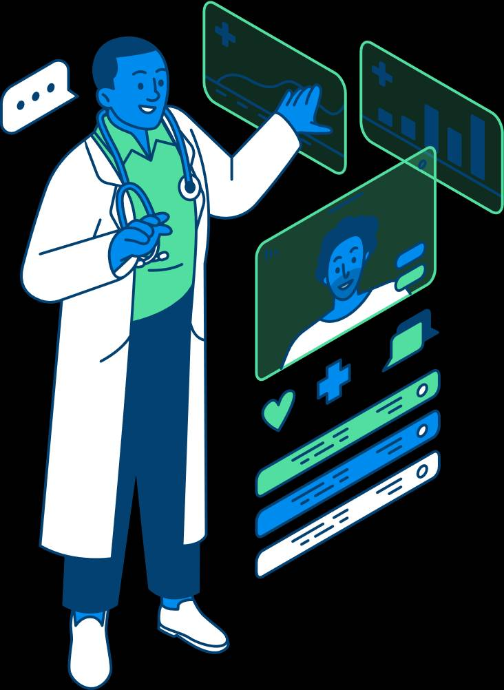


Presented By: Jasmine Kaur(23BCA10115) Kashish(23BCA10111) Anjali Choudhary(23BCA10078)
AI-Based Symptom Analyzer

Slide 2


Problem Statement
• Early diagnosis is crucial but often delayed.
• Shortage of doctors in rural & remote regions.
• Overloaded healthcare systems lead to misdiagnosis.
• Lack of accessible, low-cost predictive tools.
• Late detection increases mortality and treatment cost.

Slide 3




Objective
• Build an AI-driven system to predict diseases early.
• Provide accessible healthcare support using technology.
• Assist doctors, not replace them.
• Enable faster decision-making using data-driven insights.

Slide 4

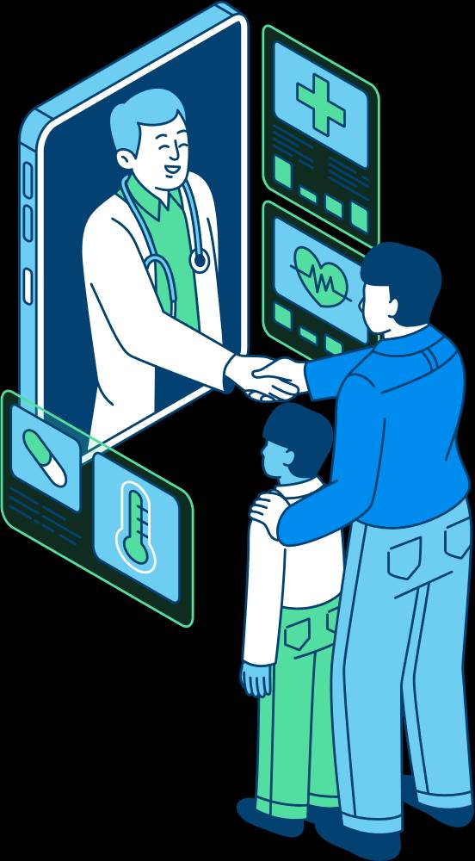

Proposed Solution
• Machine Learning model trained on medical datasets.
• User inputs symptoms → AI predicts probable disease.
• Easy interface usable by medical workers and rural clinics.
• Supports multiple disease categories.
• Provides confidence scores for transparency.
\

Slide 5
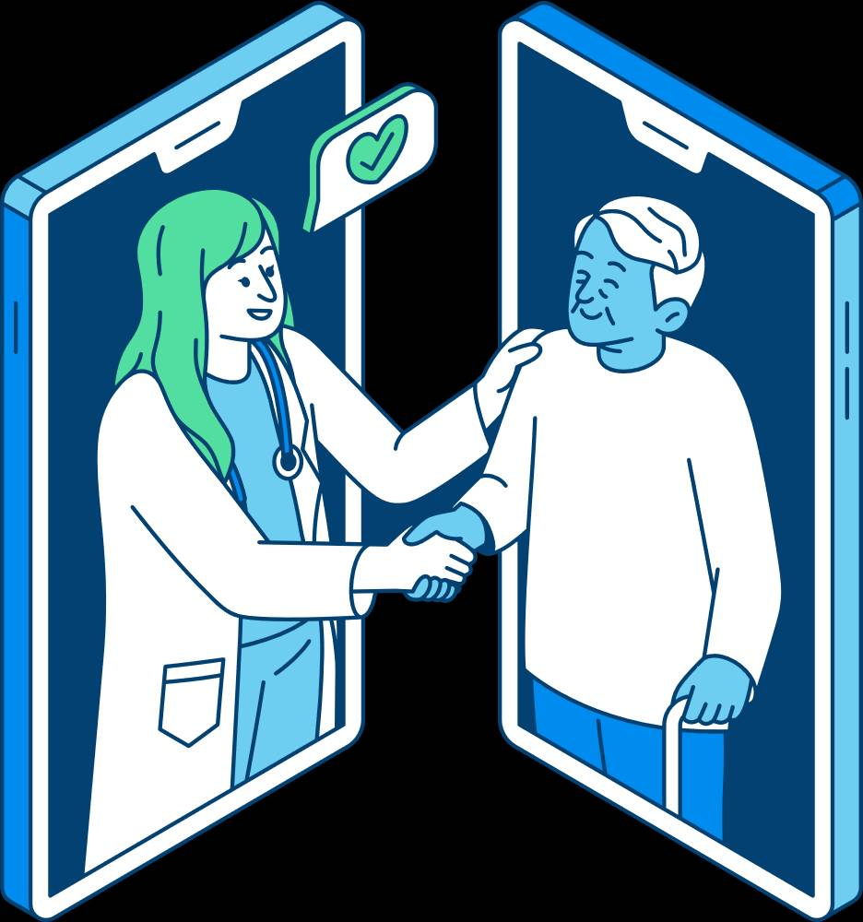
How the System Works
1. Data collection & preprocessing.
2. Model training using classification algorithms.
3. Evaluation using accuracy, precision, recall & F1 score.
4. Real-time predictions through a lightweight interface.
5. Continuous learning with updated datasets.

Slide 6
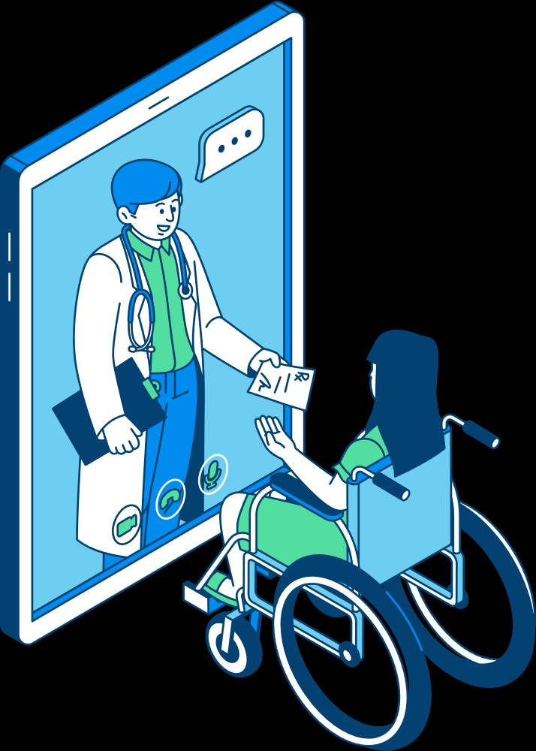
Model Accuracy & Evaluation
DIAGNOSTIC SERVICES
• Accuracy calculated using test dataset.
• Confusion matrix to analyze correct vs wrong predictions.
• Cross-validation to ensure stability.
• Achieved high performance with well-balanced metrics.

Slide 7

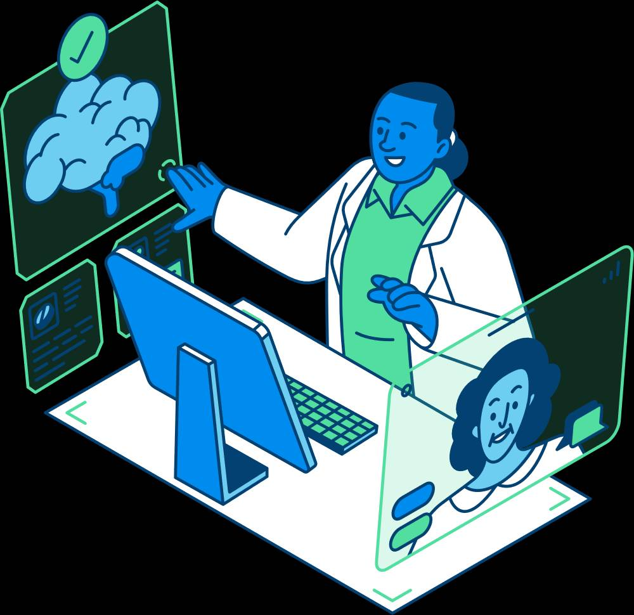
Impact on Society
• Early detection reduces risk & mortality.
• Supports rural health centers lacking specialist doctors.
• Reduces diagnostic workload for hospitals.
• Promotes digital health adoption across India.
• Helps government initiatives like Ayushman Bharat Digital Mission.

Slide 8
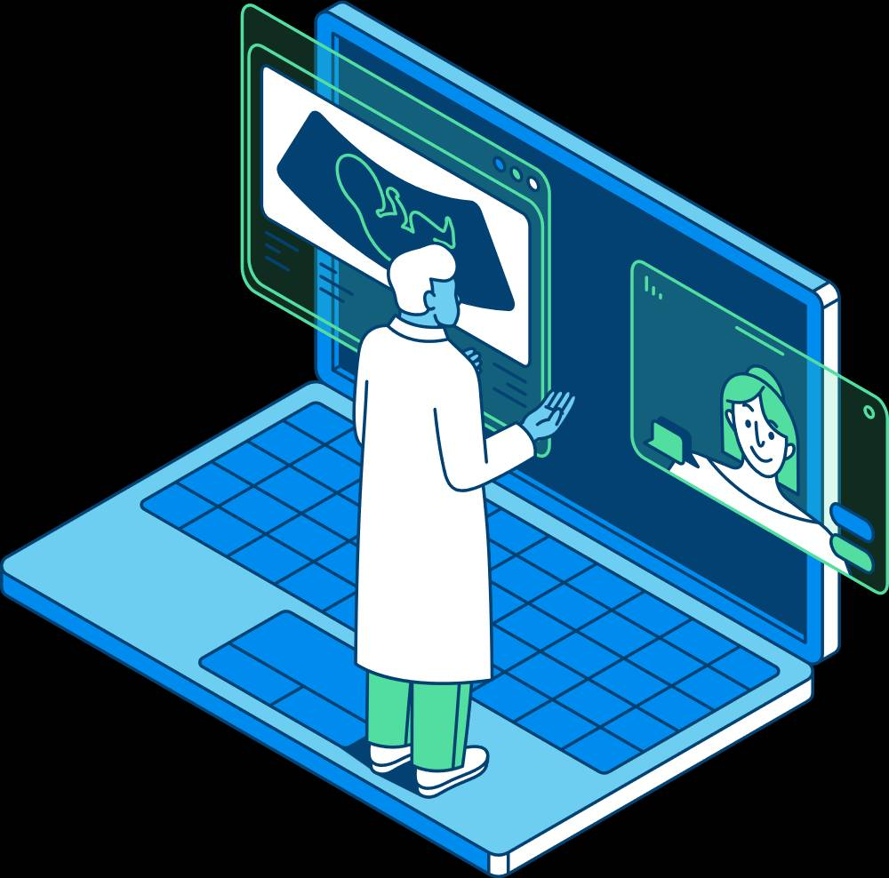

Innovation & Uniqueness
• Multidisease prediction capability.
• Can integrate with telemedicine platforms.
• Works even on low-resource devices.
• High scalability for national adoption.

Slide 9



Future Scope
• Integration with wearable devices.
• Expansion to real-time medical imaging predictions.
• Hospital management dashboard.
• Regional language support for rural deployment.
• Partnership with govt. health programmers.

Slide 10

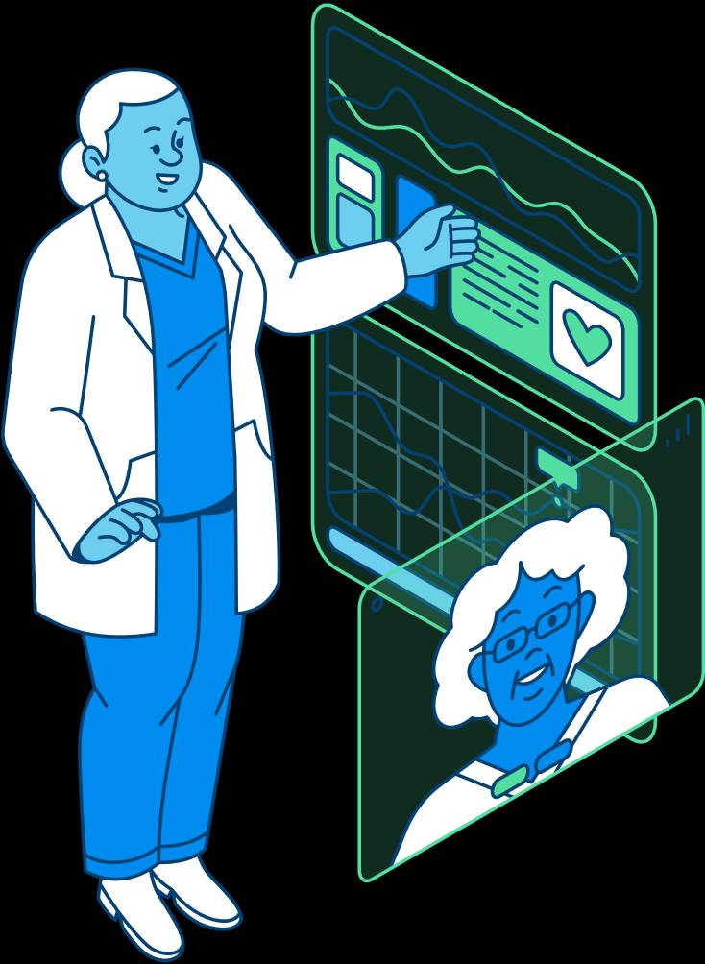
Conclusion
• AI can make healthcare accessible & affordable.
• Our system enhances diagnosis efficiency.
• Strong potential for national-level implementation.

Slide 11


THANK
YOU

